Slide 1

Black Friday Sales Prediction
Bhavesh Khanchandani
© All rights reserved by Fireblaze Technologies Pvt. Ltd.

Slide 2
Problem Statement
A retail company “ABC Private Limited” wants to understand the customer purchase behavior (specifically, purchase amount) against various products of different categories.
They have shared purchase summaries of various customers for selected high volume products from last month.
The data set also contains customer demographics (age, gender, marital status, citytype, stayincurrentcity), product details (productid and product category) and Total purchase amount from last month.
Now, they want to build a model to predict the purchase amount of customers against various products which will help them to create personalized offers for customers against different products.
© All rights reserved by Fireblaze Technologies Pvt. Ltd.

Slide 3
Proposed Solution
Data Preprocessing : This step performs all pre-processing steps such as data manipulation, data filling, converting categorical into numeric, and all processes. The EDA process involves performing 1. Univariate Analysis 2. Bivariate analysis 3. Removing Missing values if any / Outlier treatment 4. Machine Learning : Probability of purchase. and also check if the model is to be underfitting or overfitting if it has then solves this by using cross-validation technique, or perform hyperparameter tuning to improve model performance.
© All rights reserved by Fireblaze Technologies Pvt. Ltd.

Slide 4
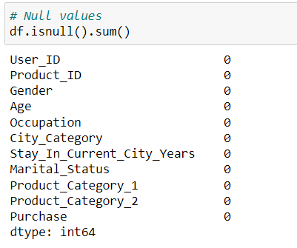
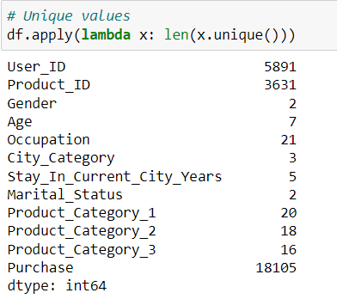
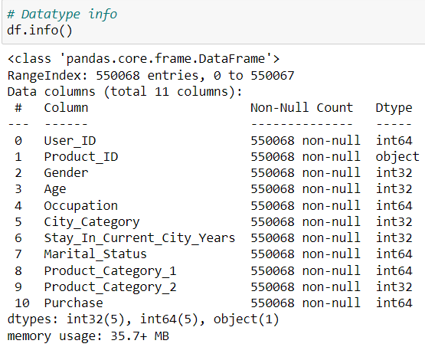
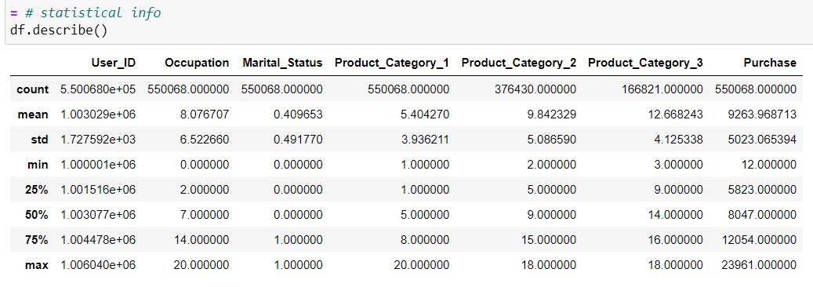
Descriptive Analysis
© All rights reserved by Fireblaze Technologies Pvt. Ltd.

Slide 5
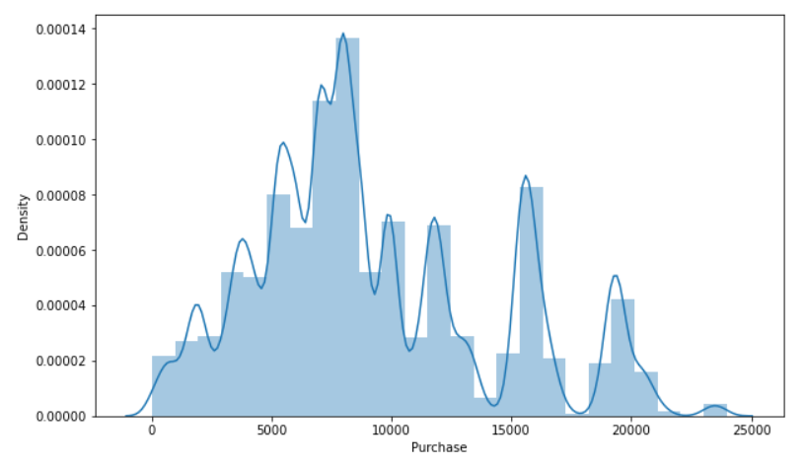
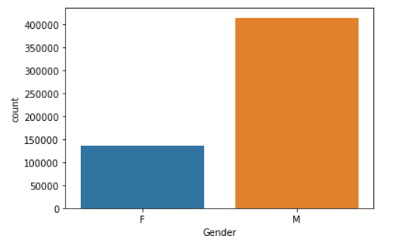
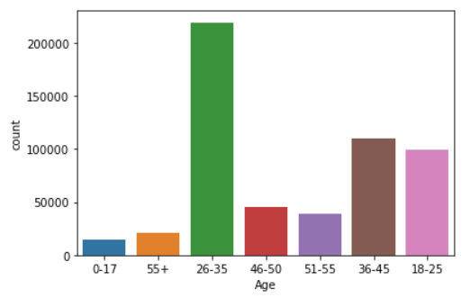
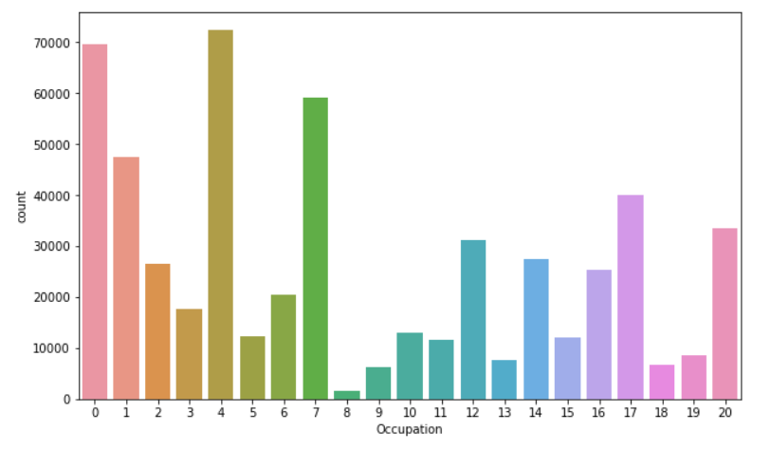
Exploratory Data Analysis
Observations
Graph 1 We can see the Highest purchase range is between 5000 to 10000
In graph 2 we can see that M ie Males have Placed more orders, Maybe they are more interested in black Friday sales than females.
In graph 3 we can see that the most orders were placed by the age group 26-35
In graph 4 we can see that occupations 0, 4, 7, have placed more orders
© All rights reserved by Fireblaze Technologies Pvt. Ltd.

Slide 6
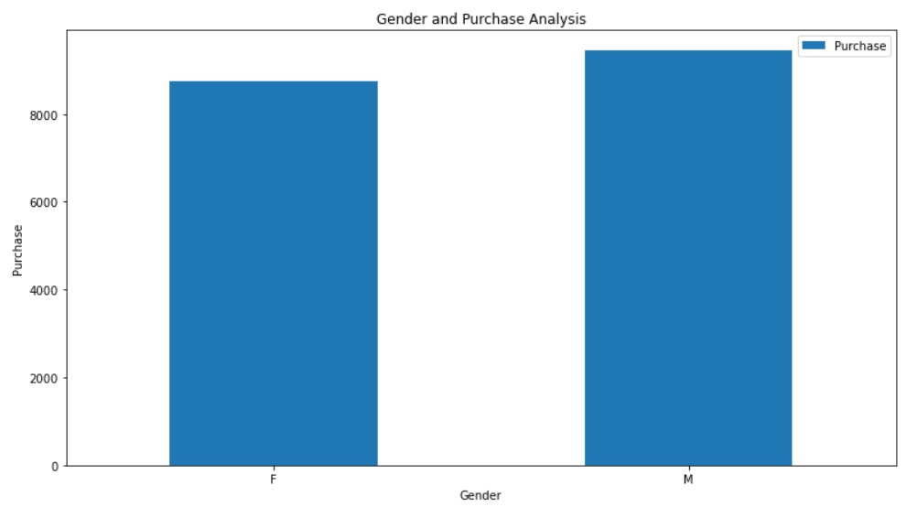
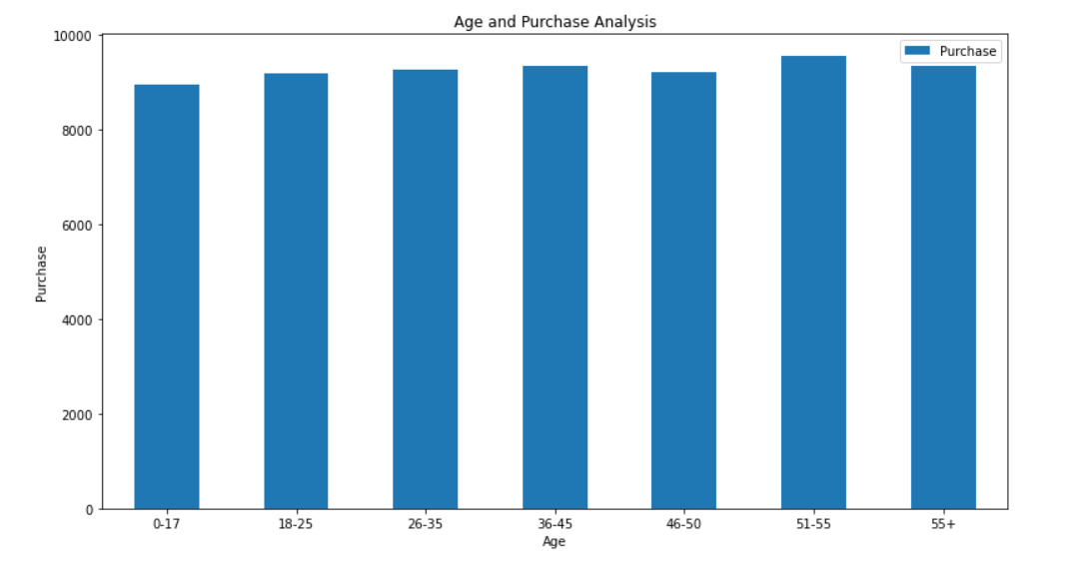
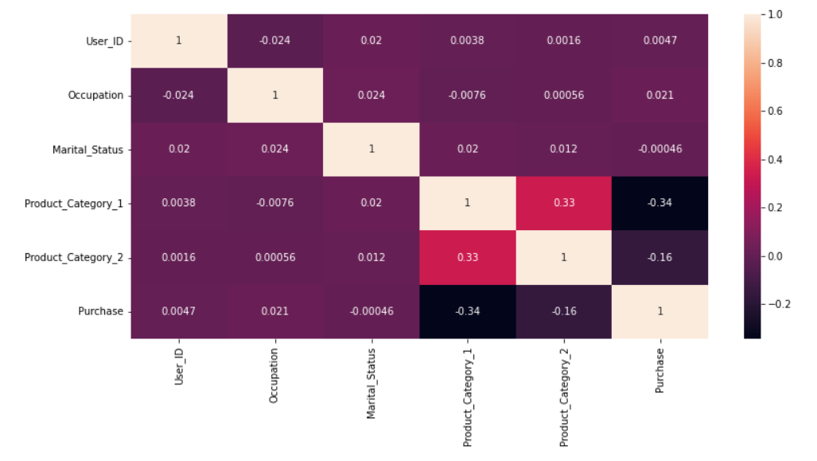
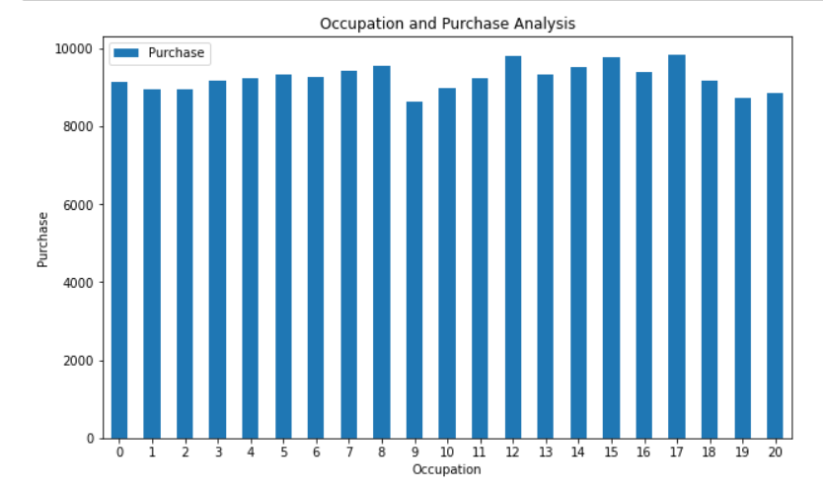
Exploratory Data Analysis
Observations
Graph 5 We can see That males have higher purchase amount than females
In graph 6 we can see age group 51-55 have higher purchase or spending capacity
In graph 7 we can see the correlation between columns
In graph 9 we can see purchases made by every occupation type
© All rights reserved by Fireblaze Technologies Pvt. Ltd.

Slide 7
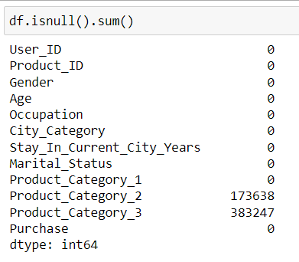
Preprocessing the Dataset
Looking for null values we can see that product category 2 and 3 have null values we can treat them by simply dropping the product category 3 column because it has many missing values more than 60%, we will fill the product category 2 column with the mean value of that column.
Outlier Treatment: We can remove the outliers by using techniques like IQR or z-score here I have used IQR technique to remove outliers in purchase column
© All rights reserved by Fireblaze Technologies Pvt. Ltd.

Slide 8
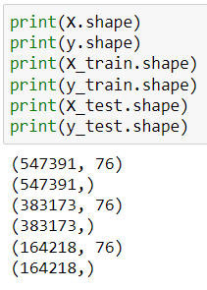
Machine Learning Modelling
Encoding
Method used One hot encoding on Gender, Age, CityCategory, StayInCurrentCityYears, Occupation, ProductCategory1, ProductCategory2 columns as this gave a good result.
Input Split
Splitting the dataset between target variable ie Purchase and input variables ie rest of the columns as X and y and running them through train_test_split
© All rights reserved by Fireblaze Technologies Pvt. Ltd.

Slide 9
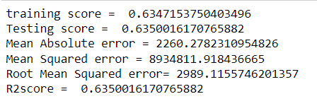
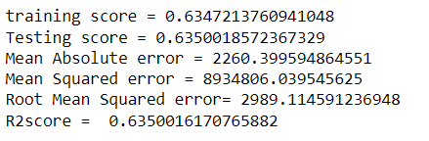
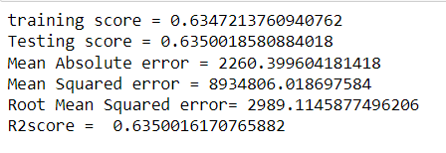
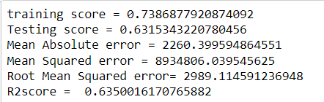
Machine Learning Modelling
We apply machine learning agorithms on the dataset lets check scores
Linear Regression
Ridge Regression
Lasso Regression
Random Forest Regression
© All rights reserved by Fireblaze Technologies Pvt. Ltd.

Slide 10
Conclusion
The Model performs almost similarly in all the algorithms
© All rights reserved by Fireblaze Technologies Pvt. Ltd.

